Slide 1


Natural Language Processing (NLP)
Sentiment Analysis of Amazon Product

Slide 2
Abstract
Recently, Ecommerce has Witnessed Rapid Development. As a Result, Online Purchasing has grown, and that has led to Growth in Online Customer Reviews of Products. They often want to know intime what consumers and the public think of their products and services. However, it is not realistic to manually read every post on the website and extract useful viewpoint information from it. Therefore, models able to predict the user sentiment from the text review or user experience from the reviews are critically important. Sentiment analysis allows large-scale processing of data in an efficient and cost-effective manner. . This thesis considers the problem of classifying reviews by their overall semantic (positive , extremely positive, negative, extremely negative and neutral). We used dataset of the Amazon iphone 13 reviews, and then built a model to predict the sentiment of the comments or reviews given by using Python and Vader (which is a rule-based sentiment analysis tool that is specifically attuned to sentiments expressed in social media, and works well on texts )

Slide 3
Agenda
Abstract
Case Study
Scraping Data
1.Selenium &
2.Beautifulsoup
Natural Language Processing
EDA
Sentiment Analysis (Using Affin.csv)
Sentiment Analysis (Using VADER)
Deployment using Streamlit

Slide 4
Case Study
Scrape the reviews of Amazon Product
Using Natural Language Processing (NLP) do the sentiment analysis of the product
Scraping Reviews
Website used – Amazon.in
Link of the product used - https://www.amazon.in/Apple-iPhone-13-128GB-Starlight/product-reviews/B09G9D8KRQ/ref=cm_cr_arp_d_viewopt_sr?ie=UTF8&reviewerType=all_reviews&filterByStar=five_star&pageNumber=1
Scraping technique used – Beautifulsoup, Selenium
Libraries used – Beautifulsoup, selenium, webdriver, ChromeDriverManager
Programming Language used – Python

Slide 5
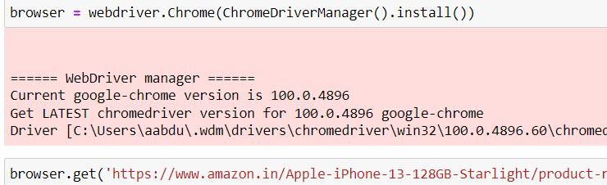
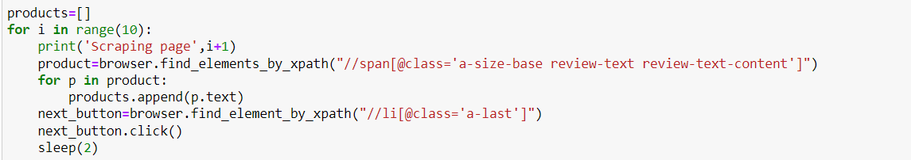
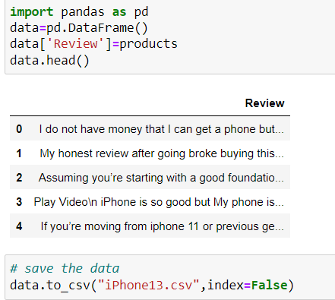
Scrape with Selenium
We import pandas, webdriver from selenium and ChromeDriverManager from webdriver_manager.chrome
Browse the required url:
Scraping the data
After the data is scraped save the data in the required path

Slide 6
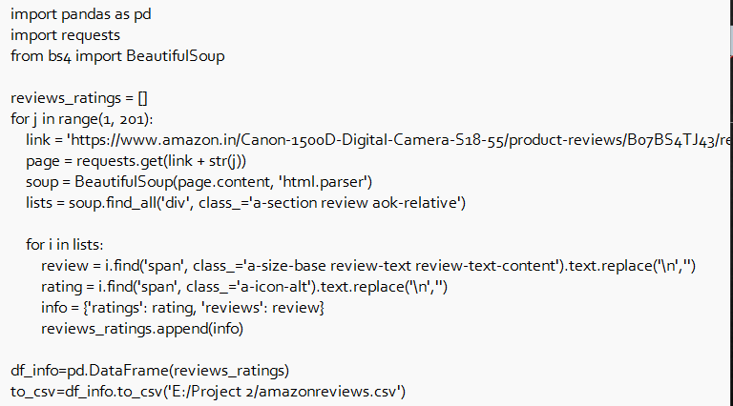
Scrape with Beautifulsoup
Scrape the data using the required url using beautifulsoup with below codes:

Slide 7
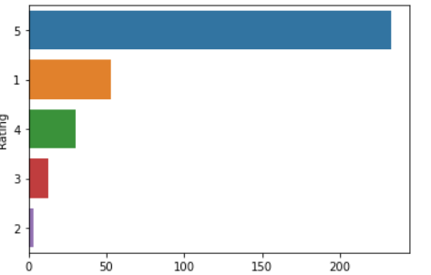
Natural Language Processing
Natural language processing (NLP) refers to the branch of computer science—and more specifically, the branch of artificial intelligence or AI—concerned with giving computers the ability to understand text and spoken words in much the same way human beings can. It allows machines to break down and interpret human language.
Count plot shows from seaborn library for observing the maximum rating. The available raw data shows the below trend.

Slide 8
EDA
Normalizing the data
To remove both the leading and the trailing characters
To remove empty strings
Joining the list into one string/text
Removing Punctuations
Tokenization / Removing stopwords / Lemmatization / Stemming
Joining the data
Named Entity Recognition (NER)

Slide 9
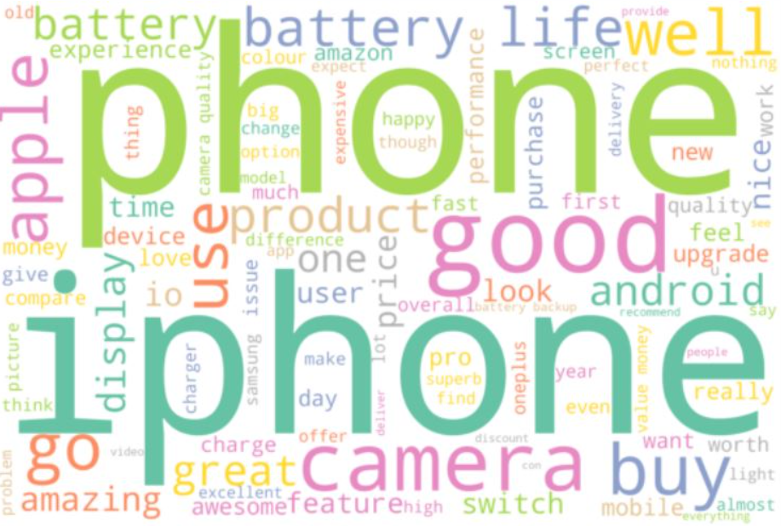
Vectorization & Feature Extraction
TF-IDF Vectorizer
Generate Word Cloud

Slide 10
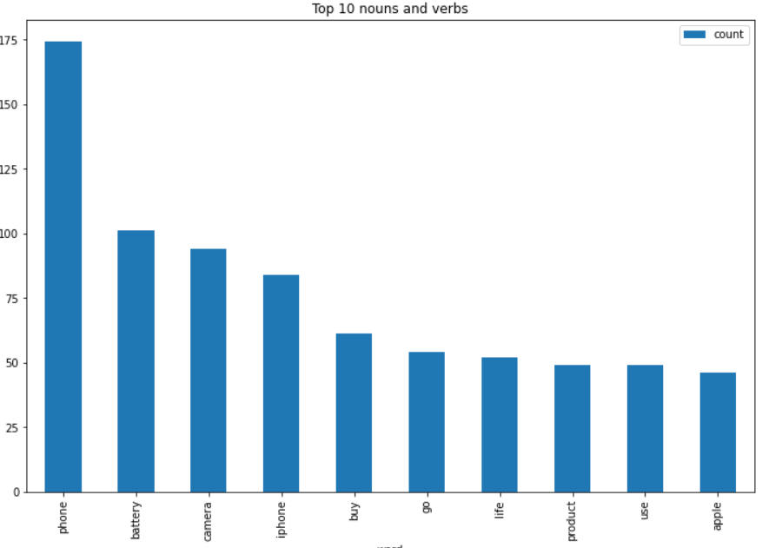
Named Entity Recognition (NER)
Filtering and counting the nouns and verbs tokens
(Barchart for top 10 nouns + verbs)

Slide 11
Sentimental Analysis
One of the most important fields or techniques of NLP is sentiment analysis.
Sentimental analysis is the use of Natural Language Processing (NLP), Machine Learning (ML), or other data analysis techniques to analyze the data and provides some insights from the data. It is the process of detecting positive, negative, or neutral sentiment in the text.
We have used fine grained sentiment analysis which gives an understanding of customer feedback. We can obtain a precise result in terms of the polarity of the input. The labels of the review will be as
Positive
Extremely positive
Negative
Extremely Negative
Neutral

Slide 12
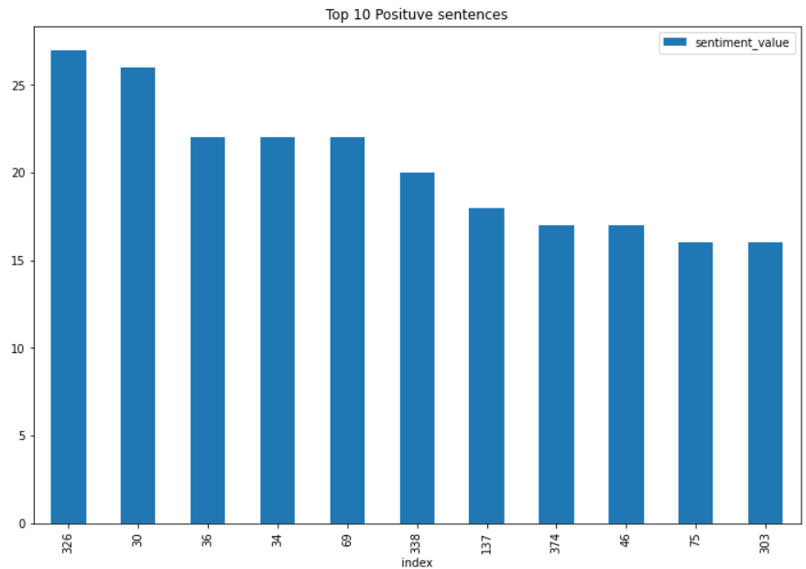
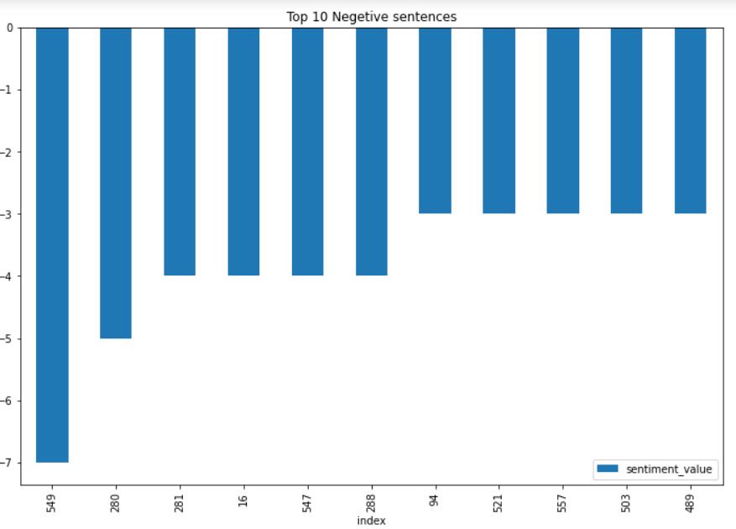
Sentiment Analysis (Using Affin.csv)
Affin.csv – default scores (sentiment value) for each word are provided in the csv file .
We compare the sentiment value to the reviews and finally obtain the sentimental score divided into positive, Extremely positive, Negative, Extremely Negative and neutral
Graphs obtained to show positive and negative sentiment score of the whole review:

Slide 13
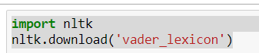
Sentiment Analysis using VADER
This gives us the polarity value ranging from -1 to +1
Libraries used :

Slide 14
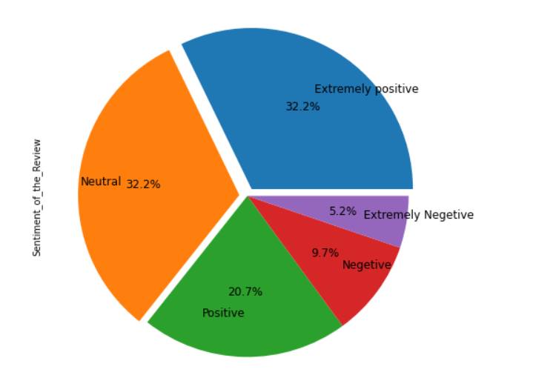
Visualization of VADER
Pie plot showing the fine grained sentiments obtained by VADER

Slide 15
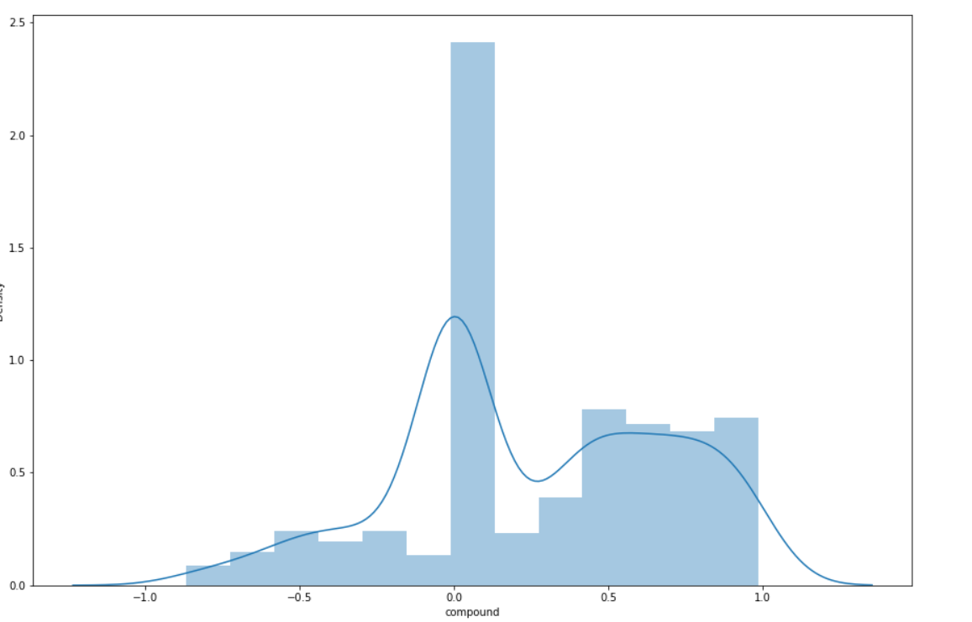
Visualization of VADER
Distribution plot showing overall polarity

Slide 16
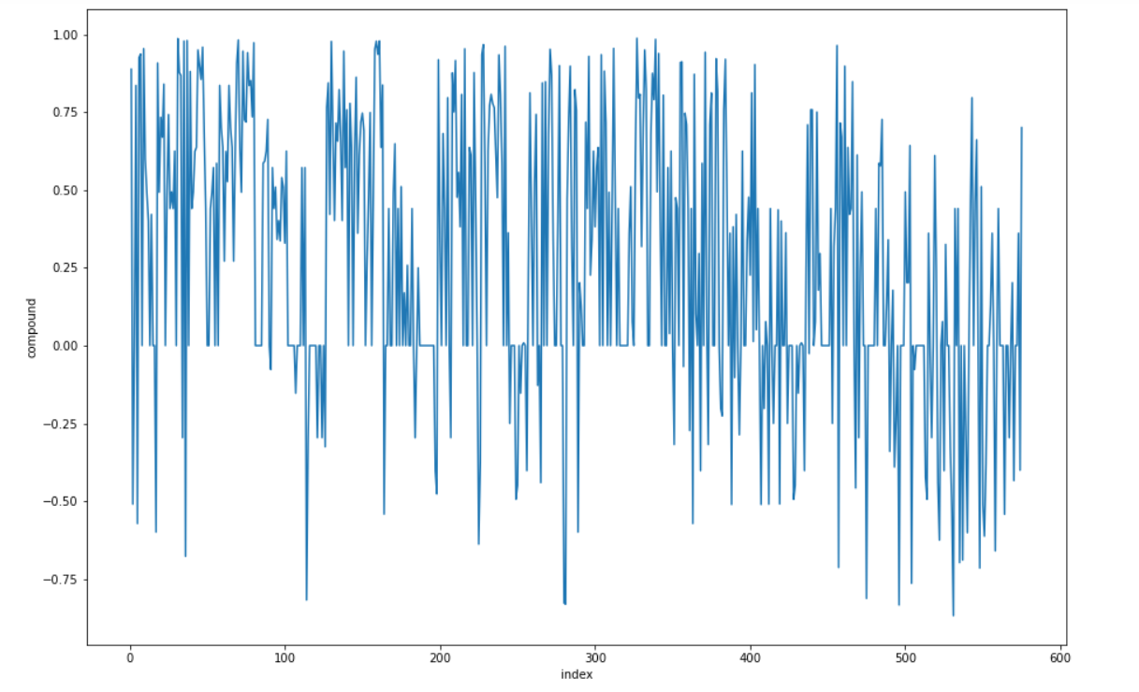
Visualization of VADER
Line plot showing polarity value for the reviews

Slide 17
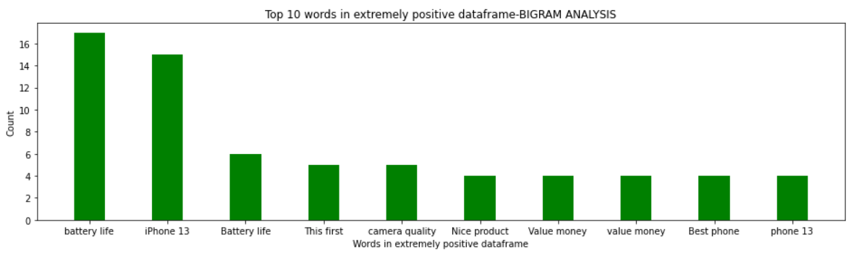
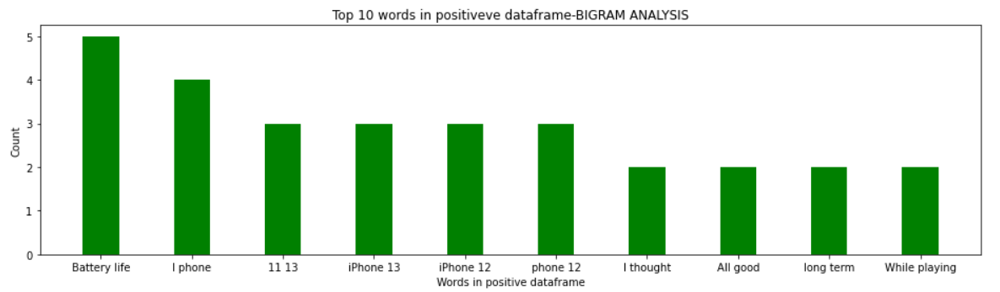
Bi-Grams
Bi-grams used to get the count of every word in the column of df dataframe

Slide 18
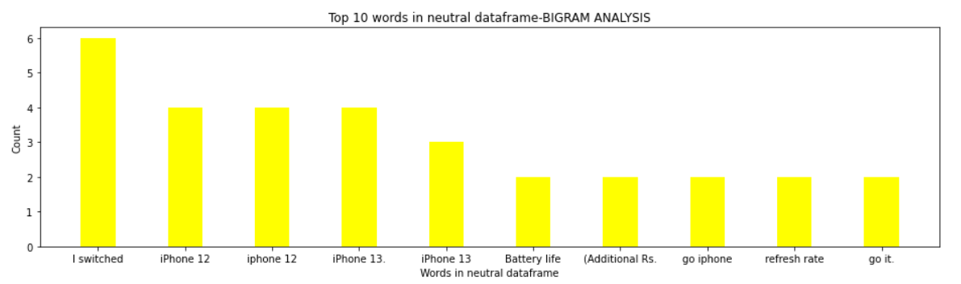
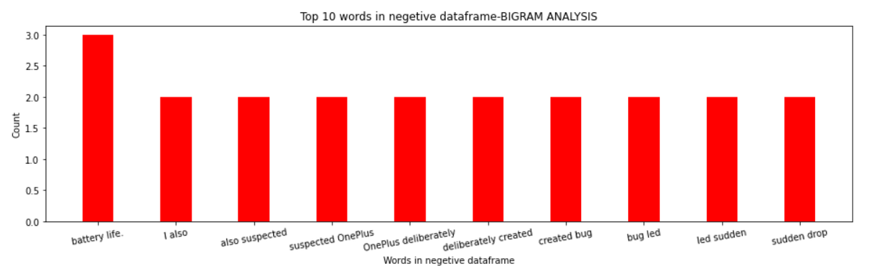
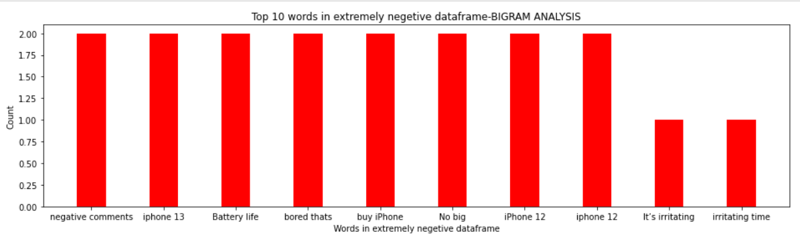
Bi-Grams

Slide 19
DEPLOYMENT

Slide 20
Libraries For Deployment
Deployment platform – Streamlit
Libraries used (exclusively for deployment) – streamlit , plotly.express and PIL(for image)
Other included libraries - pandas, numpy, matplotlib.pyplot, string, spacy and seaborn

Slide 21
Process Of Deployment
The deployment consists of 3 tabs:
Home
Reviews
About

Slide 22

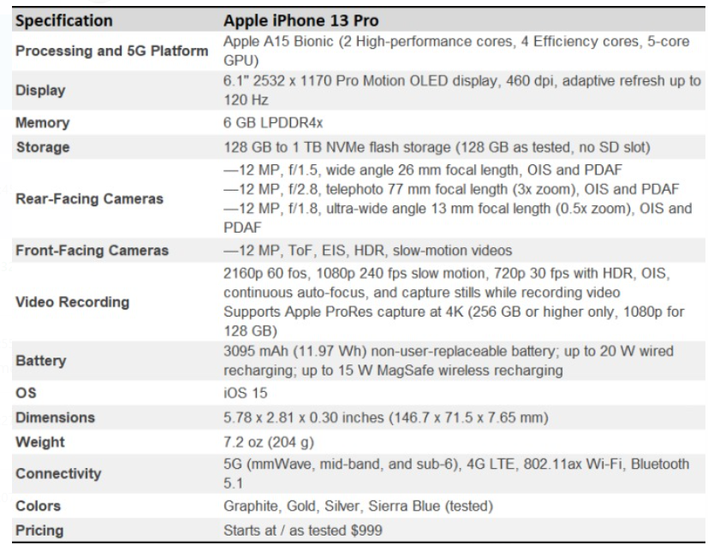

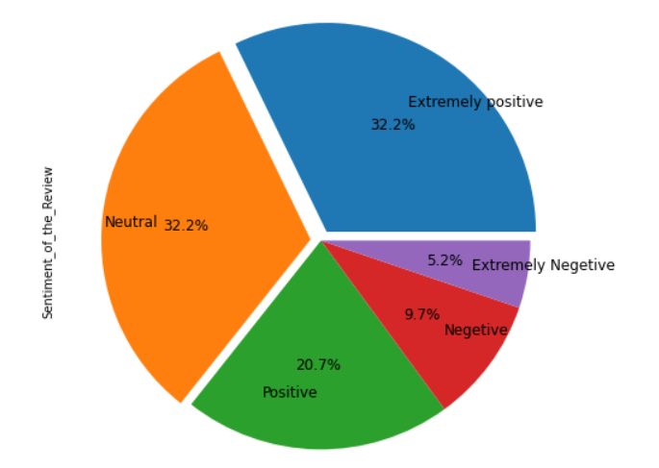
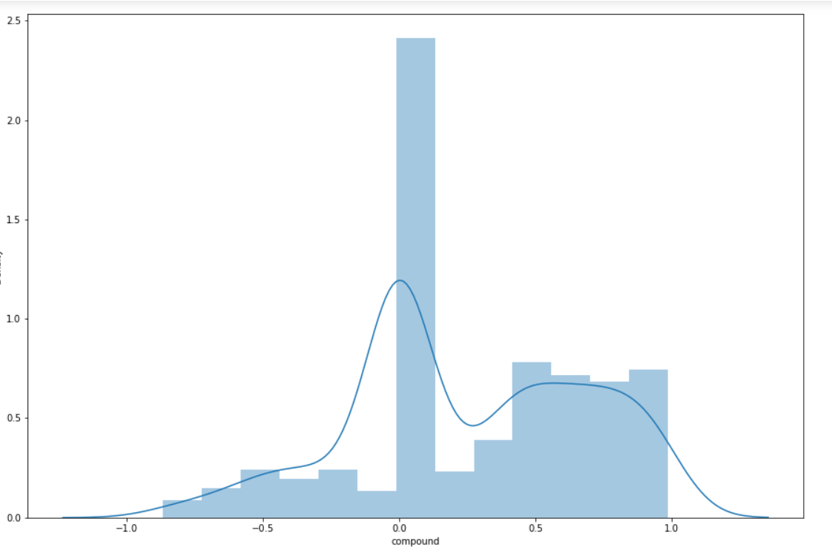
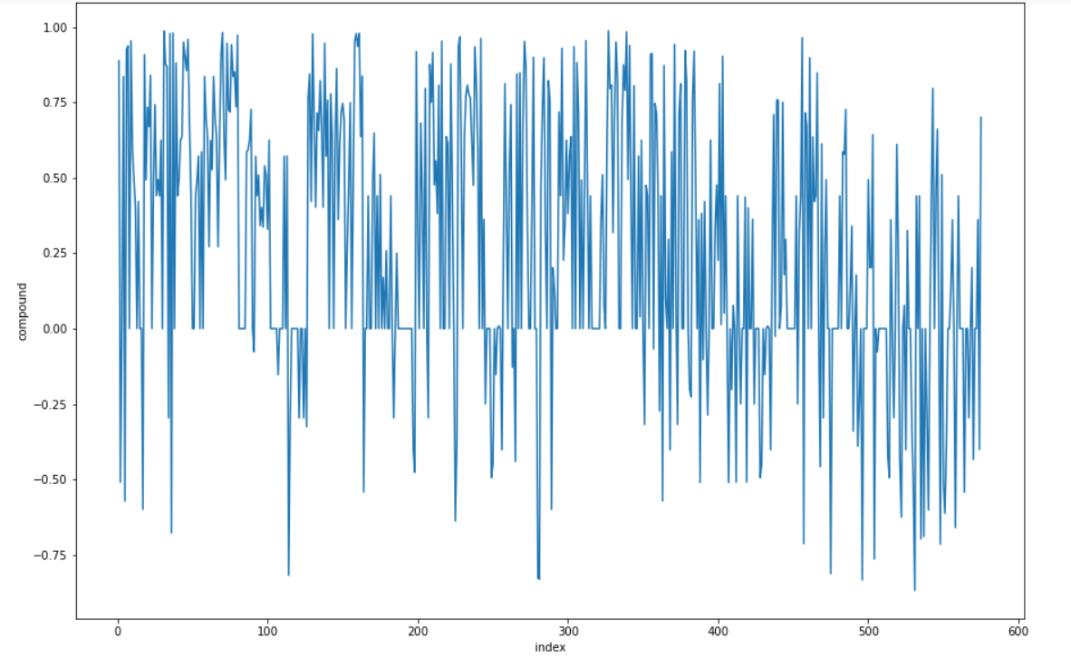
Home
Home Page – Product related images , Specifications ,product video and visualization
Header – Amazon customer review analysis with a search bar and a search button

Slide 23
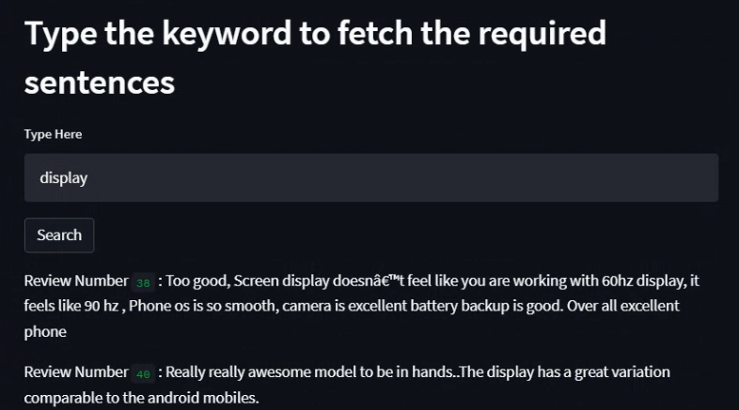
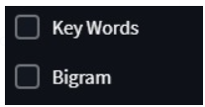
Reviews
The review tab shows all the reviews of the product
Also shows the reviews related to any specific word searched
In addition, checkboxes like “keywords and Bigrams” shows the graphs relating to keywords. This gives us an overall idea with regards to the expressions of the reviews.

Slide 24
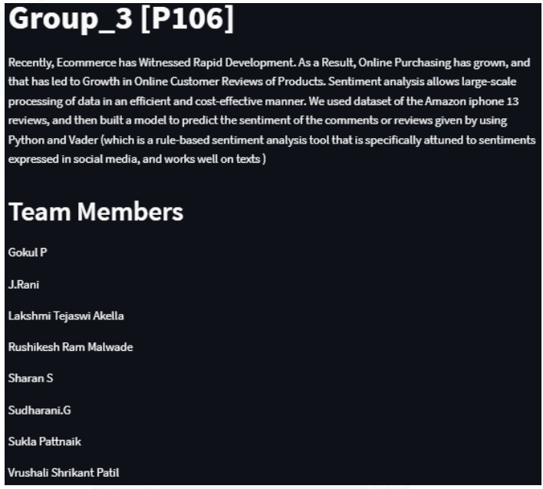
About
The about tab consists of the team members names and the abstract

Slide 25
THANK YOU

